Slide 1
Travel Planner agent
IBM AICTE PROJECT
Presented By:
Student name : Swati
College Name : Maharaja Agrasen Institute of Management and Technology , Jagadhri , Yamuna Nagar (Haryana)
Department : Bachelor of Computer Applications (BCA)

Slide 2
OUTLINE
Problem Statement
Technology used
Wow factor
End users
Result
Conclusion
GitHub Link
Future scope
IBM Certifications

Slide 3
Problem Statement
A Travel Planner Agent is an AI-powered assistant that helps users plan trips efficiently and intelligently. It uses real-time data to suggest destinations, build itineraries, and recommend transport and accommodation options. By understanding user preferences, budgets, and constraints, it tailors personalized travel plans. Integrated with maps, weather updates, and local guides, it ensures a smooth travel experience. The agent can also manage bookings, alert users to changes, and optimize schedules on the go. This smart assistant transforms complex travel planning into a seamless, enjoyable process.

Slide 4
Technology used
IBM cloud lite services
Natural Language processing technology
Framework: Lang Graph
IBM Granite model: granite-3-3-8b-instruct
Tools: Google search, Wikipedia search , Weather, Web crawler, Duck Duck Go search

Slide 5
IBM cloud services used
IBM Cloud Watsonx AI Studio: IBM Watsonx.ai Studio is a cloud-based platform for building, training, and deploying AI models, including traditional machine learning and generative AI. It supports foundation models, AutoAI, and integrates with governance and data tools for end-to-end AI lifecycle management.
IBM Cloud Watsonx AI runtime: IBM watsonx.ai Runtime is the backend service for running and deploying AI models, including foundation models and machine learning workflows, with support for prompt-based inference, AutoAI, and scalable APIs. It powers the execution layer of Watsonx.ai Studio.
IBM Cloud Agent Lab: IBM Cloud Agent Lab is a development environment for building, testing, and deploying intelligent AI agents and automation workflows on IBM Cloud.
IBM Granite foundation model: IBM Granite foundation model is IBM's family of enterprise-grade large language models designed for trusted, efficient, and domain-adaptable generative AI applications.

Slide 6
Wow factors
Imagine a travel assistant that thinks ahead, adapts in real time, and handles everything from planning to booking—tailored perfectly to you. With live updates, smart scheduling, and instant rebooking, this AI agent makes travel stress-free and unforgettable.
Features:
AI-Powered Personalization – Understands user preferences, budget, and constraints to tailor travel plans uniquely for each user.
Real-Time Data Integration – Uses live data for destinations, weather, transport, and accommodation to keep plans updated and relevant.
End-to-End Travel Management – Not just planning, but also booking, alerting, and optimizing schedules on the go.
Seamless Experience – Turns a complex, time-consuming task into an effortless and enjoyable journey.

Slide 7
End users
Travel Agents / Tour Operators
Leisure Travelers
Business Travelers
Frequent Travelers
Group Travelers
Budget Travelers
Luxury Travelers
Solo Travelers

Slide 8
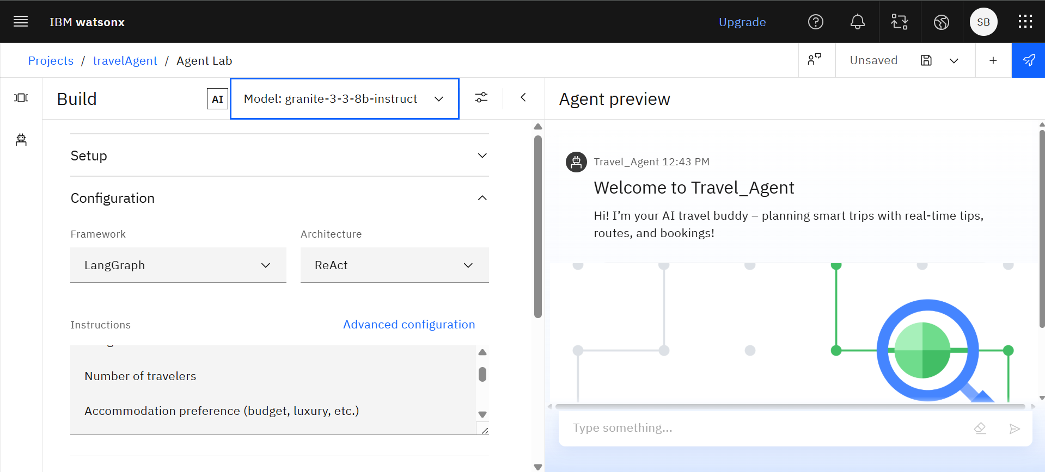
Results
This agent uses the Granite-3-3-8b-instruct model with LangGraph and ReAct to create an interactive AI travel assistant that plans trips based on user inputs like number of travelers and accommodation preferences.

Slide 9
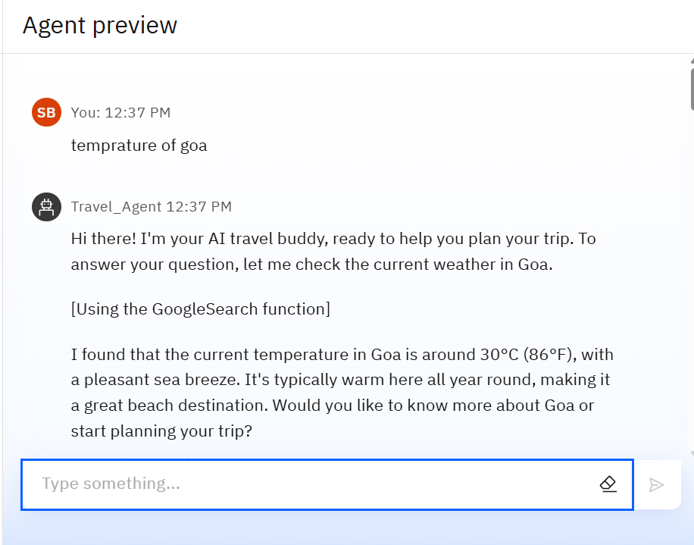
Results
You can access temperature of the place and plan accordingly

Slide 10
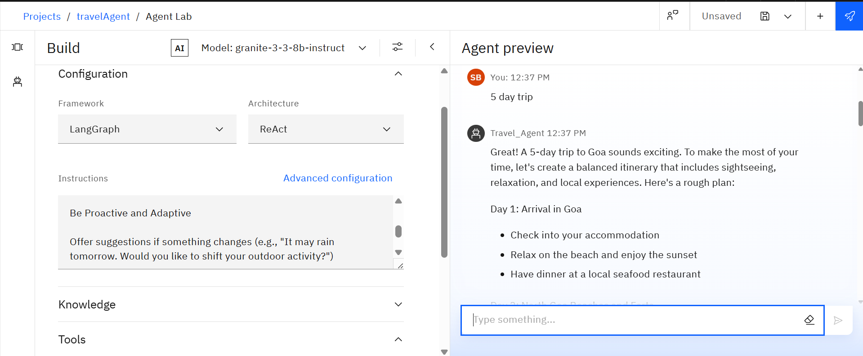
Results
you can plan your entire itinerary through this interface

Slide 11
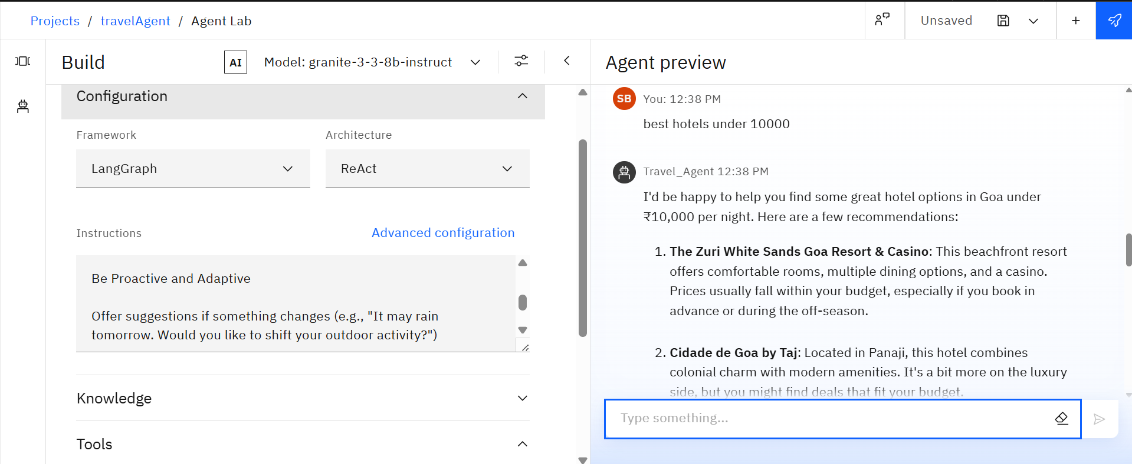
Results
We can get recommendation of hotels related to the budget

Slide 12
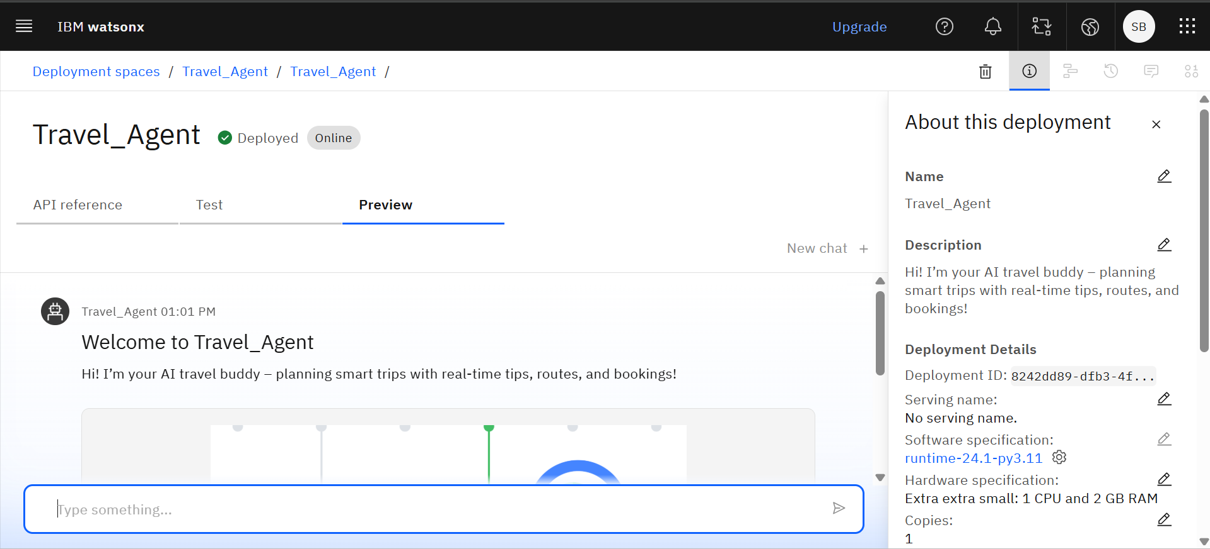
Results
Deployed AI Agent
In IBM Cloud, a Deployment Space is a workspace or environment specifically designed to deploy, test, and manage machine learning models and AI assets.

Slide 13
Conclusion
Using IBM watsonx.ai, we successfully created an intelligent travel agent powered by foundation models like IBM Granite. The development process involved designing prompts, integrating retrieval-augmented generation (RAG) for personalized recommendations, and testing workflows within Watsonx.ai Studio.
After building and validating the model, we deployed it seamlessly via Watsonx.ai Runtime as a scalable API, enabling real-time responses and integration into web or mobile platforms.
This end-to-end deployment showcases how watsonx.ai supports rapid, governed, and production-ready AI solutions.

Slide 14
Github Link
https://github.com/SwatiBadola1/Travel-Agent

Slide 15
Future scope
Voice & Multilingual Support – Enable users to interact via voice and in multiple languages.
AI-Based Personalization – Use machine learning to suggest smarter, user-specific plans.
AR/VR Destination Previews – Let users explore places virtually before visiting.
Eco-Friendly Travel Options – Promote sustainable transport and accommodations.
Emergency Support Integration – Provide real-time help and alerts during travel.
Social Trip Planning – Allow collaborative planning with friends or groups.
Offline Access – Provide access to itineraries and maps without internet.

Slide 16
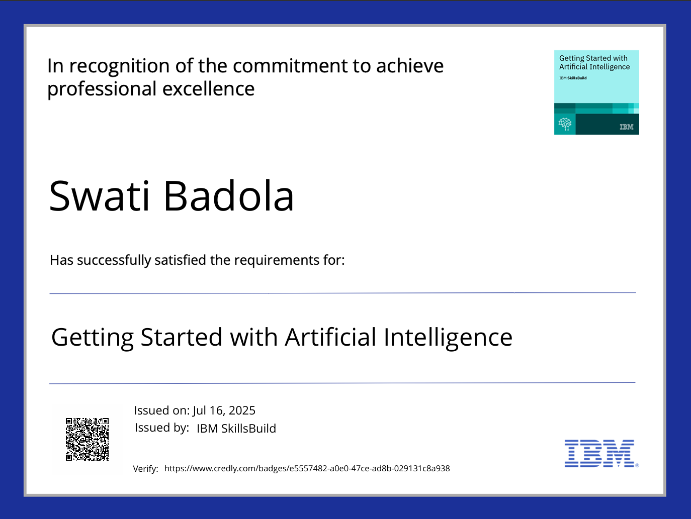
IBM Certifications

Slide 17
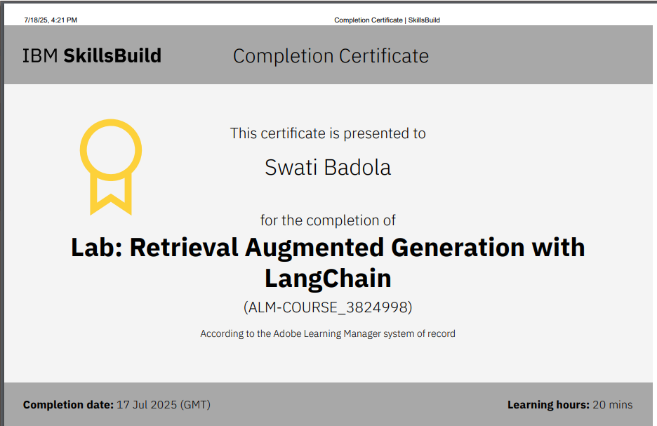
RAG LAB certificate

Slide 18
THANK YOU

